Slide 1
Introduction to NOSQL Databases

Slide 2
Background
Relational databases → mainstay of business
ACID – Atomicity, Consistency, Isolation, Durable
Web-based applications caused spikes
explosion of social media sites (Facebook, Twitter) with large data needs
rise of cloud-based solutions such as Amazon S3 (simple storage solution)
Hooking RDBMS to web-based application becomes trouble

Slide 3
Issues with scaling
Best way to provide ACID and rich query model is to have the dataset on a single machine
Bottleneck!
Scaling up (or vertical scaling: make a “single” machine more powerful)
→ dataset is just too big!
Scaling out (or horizontal scaling: adding more smaller/cheaper servers) is a better choice
Different approaches for horizontal scaling (multi-node database):
Master/Slave
Sharding (partitioning)

Slide 4
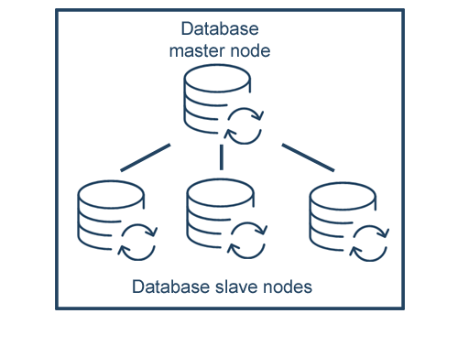
Scaling out RDBMS: Master/Worker
Master/Worker
All writes are written to the master
All reads performed against the replicated worker databases
Critical reads may be incorrect as writes may not have been propagated down
Large datasets can pose problems as master needs to duplicate data to workers
Database Worker Nodes

Slide 5
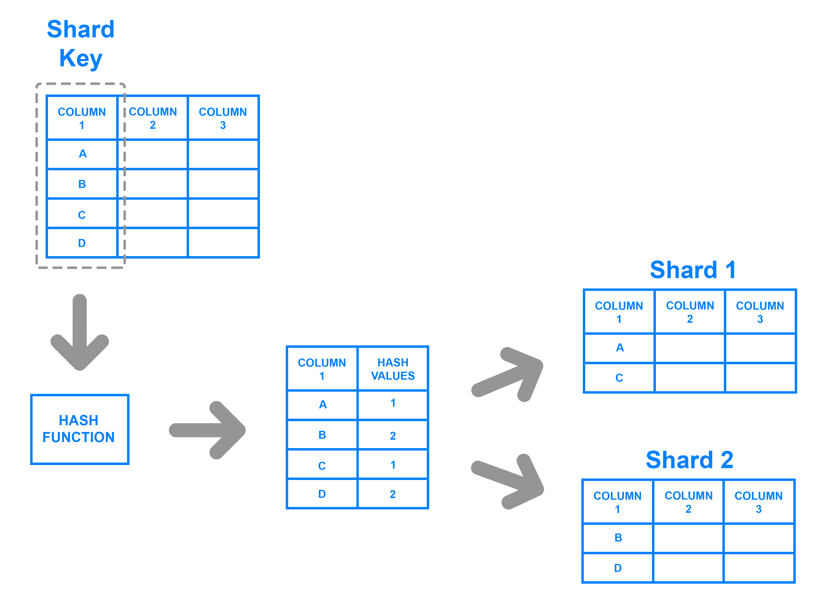
Scaling out RDBMS: Sharding
Sharding (Partitioning)
Table is partitioned and distributed across nodes by rows
Scales well for both reads and writes
Not transparent, application needs to be partition-aware
Difficult to have relationships/joins across partitions
Loss of referential integrity across shards

Slide 6
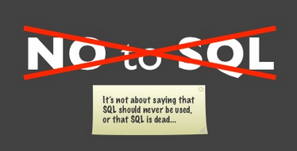
What is NoSQL?
The Name:
Stands for Not Only SQL
The term NOSQL was introduced by Carl Strozzi in 1998 to name his file-based database
It was again re-introduced by Eric Evans when an event was organized to discuss open source distributed databases
Eric states that “… but the whole point of seeking alternatives is that you need to solve a problem that relational databases are a bad fit for. …”

Slide 7
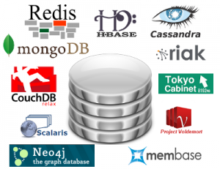
What is NoSQL?
Key features (advantages):
non-relational
don’t require predefined schema
data are replicated to multiple nodes (so, identical & fault-tolerant) and can be partitioned:
down nodes easily replaced
no single point of failure
horizontally scalable
cheap, easy to implement (open-source)
massive write performance
fast key-value access

Slide 8
What is NoSQL?
Disadvantages:
Don’t fully support relational features
Often, there is no join, group by, order by operations (except within partitions)
no referential integrity constraints across partitions
No declarative query language (e.g., SQL) → more programming
This is changing
Relaxed ACID (see CAP theorem) → fewer guarantees
No easy integration with other applications that support SQL
This is changing

Slide 9
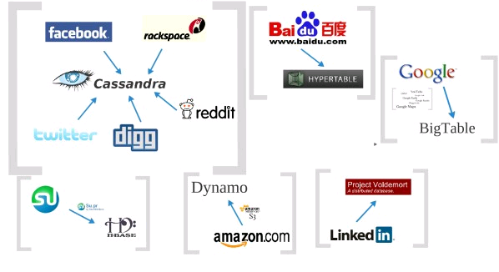


Who is using them?

Slide 10
3 major papers for NoSQL
Three major papers were the “seeds” of the NOSQL movement:
BigTable (Google)
DynamoDB (Amazon)
Ring partition and replication
Gossip protocol (discovery and error detection)
Distributed key-value data stores
Eventual consistency
CAP Theorem
Notes:
-> BigTable: http://labs.google.com/papers/bigtable.html
-> Dynamo: http://www.allthingsdistributed.com/2007/10/amazons_dynamo.html and http://www.allthingsdistributed.com/files/amazon-dynamo-sosp2007.pdf
-> Amazon and consistency
* http://www.allthingsdistributed.com/2010/02
* http://www.allthingsdistributed.com/2008/12

Slide 11
The Perfect Storm
Large datasets, acceptance of alternatives, and dynamically-typed data has come together in a “perfect storm”
Not a backlash against RDBMS
SQL is a rich query language that cannot be rivaled by the current list of NoSQL offerings

Slide 12
CAP Theorem
Suppose three properties of a distributed system (sharing data)
Consistency:
Availability:
Partition-tolerance:
A
C
P

Slide 13
CAP Theorem
All client always have the same view of the data
Availability
Consistency
Partition tolerance

Slide 14
CAP Theorem
Each client always can read and write.
Availability
Consistency
Partition tolerance

Slide 15
CAP Theorem
A system can continue to operate in the presence of a network partitions
Availability
Consistency
Partition tolerance

Slide 16
CAP Theorem
Brewer’s CAP Theorem:
For any system sharing data, it is “impossible” to simultaneously guarantee all three properties
You can have at most two of these three properties for any shared-data system
Very large systems will “partition” at some point:
That leaves either C or A to choose from (traditional DBMS prefers C over A and P )
In almost all cases, you would choose A over C (except in specific applications such as order processing)

Slide 17
CAP Theorem
Many NoSQL systems target Consistency
The system should always be available but not necessarily consistent.
Consistency
2 types of consistency:
Strong consistency – ACID (Atomicity, Consistency, Isolation, Durability)
Weak consistency – BASE (Basically Available Soft-state Eventual consistency)

Slide 18
CAP Theorem
A consistency model determines rules for visibility and apparent order of updates
Example:
Row X is replicated on nodes M and N
Client A writes row X to node N
Some period of time t elapses
Client B reads row X from node M
Does client B see the write from client A?
Consistency is a continuum with tradeoffs
For NoSQL that chooses Availability over Consistency, the answer would be: “maybe”
CAP theorem states: “strong consistency can't be achieved at the same time as availability and partition-tolerance”

Slide 19
CAP Theorem
Eventual consistency
When no updates occur for a long period of time, eventually all updates will propagate through the system and all the nodes will be consistent
Cloud computing
ACID is hard to achieve, moreover, it is not always required, e.g. for blogs, status updates, product listings, etc.

Slide 20
NoSQL categories
Key-value
Example: DynamoDB, Voldemort, Scalaris
Document-based
Example: MongoDB, CouchDB
Column-based
Example: BigTable, Cassandra, Hbase
Graph-based
Example: Neo4J, InfoGrid
“No-schema” is a common characteristic of most NoSQL storage systems
Provide “flexible” data types

Slide 21
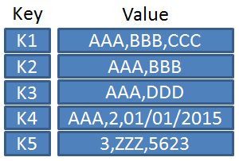
Key-value
Focus on scaling to huge amounts of data
Designed to handle massive load
Based on Amazon’s Dynamo paper
Data model: (global) collection of Key-value pairs
Dynamo - ring partitioning and replication
Example: (DynamoDB)
items having one or more attributes (name, value)
An attribute can be single-valued or multi-valued like set.
items are combined into a table

Slide 22
Key-value
Basic API access:
get(key): extract the value given a key
put(key, value): create or update the value given its key
delete(key): remove the key and its associated value
execute(key, operation, parameters): invoke an operation to the value (given its key) which is a special data structure (e.g. List, Set, Map .... etc)
Implementation: efficiency, scalability, fault-tolerance
Records distributed to nodes based on key
Replication
Single-record transactions, “eventual consistency”
Notes:
-> http://chariotsolutions.blogspot.com/2010/01/why-you-need-nosql-in-your-toolbox.html

Slide 23
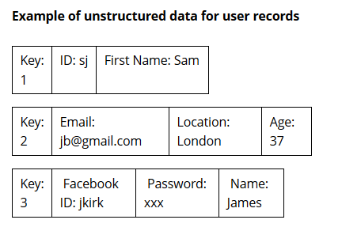
“Value” is stored as a “blob”
- Without caring or knowing what is inside
- Application is responsible for understanding the data
In simple terms, a NoSQL Key-Value store is a single table with two columns: one being the (Primary) Key, and the other being the Value.
Each record may have a different schema

Slide 24
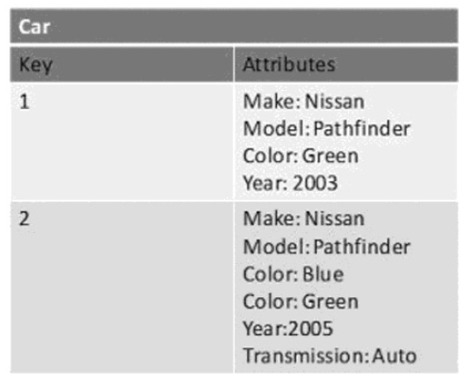
Example

Slide 25
Original Key-Value Store was Dynamo -
Amazon’s Highly-Available Key-Value Store
• Main observation from Amazon:
– “There are many services on Amazon’s platform that only need primary-key access to a data store.”
E.g., Best seller lists, shopping carts, customer preferences, session management, sales rank, product catalog
Dynamo is now superseded by DynamoDB.
http://www.allthingsdistributed.com/files/amazon-dynamo-sosp2007.pdf

Slide 26
Dynamo applies an MD5 hash on the key to generate a 128-bit identifier, which is then used to determine the storage node that is responsible for serving the key.
- This allows the data store to scale incrementally - dynamically partition the data over the set of nodes (i.e., storage hosts) in the system.
The simplicity of Key-Value Stores makes them ideally suited to extremely fast, highly-scalable retrieval of the values needed for application tasks like managing user profiles or sessions or retrieving product names.
This is why Amazon makes extensive use of its own Key-Value system, Dynamo, in its shopping cart.

Slide 27
Key-value
Pros:
very fast
very scalable (horizontally distributed to nodes based on key)
simple data model
eventual consistency
fault-tolerance
Cons:
- Can’t model more complex data structure such as objects
Notes:
-> http://chariotsolutions.blogspot.com/2010/01/why-you-need-nosql-in-your-toolbox.html

Slide 28
Key-value
Name | Producer | Data model | Querying
SimpleDB | Amazon | set of couples (key, {attribute}), where attribute is a couple (name, value) | restricted SQL; select, delete, GetAttributes, and PutAttributes operations
Redis | Salvatore Sanfilippo | set of couples (key, value), where value is simple typed value, list, ordered (according to ranking) or unordered set, hash value | primitive operations for each value type
Dynamo | Amazon | like SimpleDB | simple get operation and put in a context
Voldemort | LinkedIn | like SimpleDB | similar to Dynamo
Notes:
-> http://chariotsolutions.blogspot.com/2010/01/why-you-need-nosql-in-your-toolbox.html

Slide 29
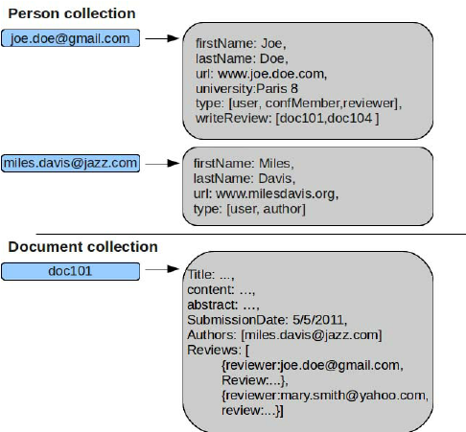
Document-based
Can model more complex objects
Inspired by Lotus Notes
Data model: collection of documents
Document: JSON, XML, other semi-structured formats.
Basic operations:
Insert(key,document),
Fetch(key),
Update(key),
Delete(key)
also Fetch() based on document contents

Slide 30
Document-based
Name | Producer |  | Data model |  | Querying
MongoDB |  | 10gen |  | object-structured documents stored in collections; each object has a primary key called ObjectId |  | manipulations with objects in collections (find object or objects via simple selections and logical expressions, delete, update,)
Couchbase |  | Couchbase |  | document as a list of named (structured) items (JSON document) |  | by key and key range, views via Javascript and MapReduce

Slide 31
Records within a single table can have different structures.
An example record from MongoDB, using JSON format, might look like
{
“_id” : ObjectId(“4fccbf281168a6aa3c215443″),
“first_name” : “Thomas”,
“last_name” : “Jefferson”,
“address” : {
“street” : “1600 Pennsylvania Ave NW”,
“city” : “Washington”,
“state” : “DC”
}
}
Embedded object
Though records are called documents, they are not documents in the sense of a word processing document, although you can store binary data (using BSON format) in any of the fields in the document. You can also modify the structure of any document on the fly by adding and removing members from the document, either by reading the document into your program, modifying it and re-saving it, or by using various update commands.

Slide 32
Document databases are good for storing and managing Big Data-size collections of literal documents, like text documents, email messages, and XML documents, as well as conceptual “documents” like de-normalized (aggregate) representations of a database entity such as a product or customer.
They are also good for storing “sparse” data in general, that is to say irregular (semi-structured) data that would require an extensive use of “nulls” in an RDBMS.

Slide 33
MongoDB query
SQL | Mongo
SELECT * FROM inventory | db.inventory.find( {} )
SELECT * FROM inventory WHERE status = "D" | db.inventory.find( { status: "D" } )
SELECT * FROM inventory WHERE status in ("A", "D") | db.inventory.find( { status: { $in: [ "A", "D" ] } } )
SELECT * FROM inventory WHERE status = "A" AND qty < 30 | db.inventory.find( { status: "A", qty: { $lt: 30 } } )
SELECT * FROM inventory WHERE status = "A" OR qty < 30 | db.inventory.find( { $or: [ { status: "A" }, { qty: { $lt: 30 } } ] } )

Slide 34
Mongodb
Data types: bool, int, double, string, object(bson), oid, array, null, date.
Database and collections are created automatically.
Lots of Language Drivers.
Capped collections are fixed size collections, buffers, very fast, FIFO, good for logs. No indexes.
Object id are generated by client, 12 bytes packed data. 4 byte time, 3 byte machine, 2 byte pid, 3 byte counter.
Possible to refer other documents in different collections but more efficient to embed documents.
Replication is very easy to setup. You can read from workers.

Slide 35
Mongodb
Connection pooling is done for you. Sweet.
Supports aggregation.
MapReduce with JavaScript.
You have indexes, B-Trees. Ids are always indexed.
Updates are atomic. Low contention locks.
Querying mongo done with a document:
Lazy, returns a cursor.
Reduceable to SQL, select, insert, update limit, sort etc.
There is more: upsert (either inserts or updates)
Several operators:
$ne, $and, $or, $lt, $gt, $incr,$decr and so on.
Repository Pattern makes development very easy.

Slide 36
Couchdb
Availability and Partial Partition Tolerance.
Views are used to query. Map/Reduce.
MVCC – Multi-version Concurrency Control. No locks.
A little overhead with this approach due to garbage collection.
Conflict resolution.
Very simple, REST based. Schema Free.
Shared nothing, seamless peer based Bi-Directional replication.
Auto Compaction. Manual with Mongodb.
Documents and indexes are kept in memory and flushed to disc periodically.
Documents have states, in case of a failure, recovery can continue from the state documents were left.
No built in auto-sharding, there are open source projects.
You can’t define your indexes.

Slide 37
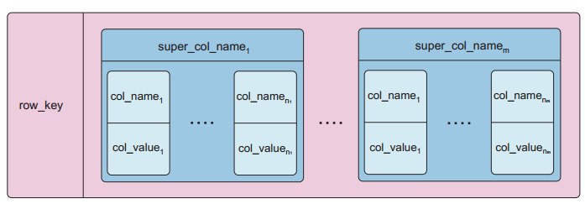
Column-based
Based on Google’s BigTable paper
Like column oriented relational databases (store data in column order) but with a twist
Tables similarly to RDBMS, but handle semi-structured
Data model:
Collection of Column Families
Column family = (key, value) where value = set of related columns (standard, super)
indexed by row key, column key and timestamp
allow key-value pairs to be stored (and retrieved on key) in a massively parallel system
storing principle: big hashed distributed tables
properties: partitioning (horizontally and/or vertically), high availability etc. completely transparent to application
* Better: extendible records

Slide 38
Column-based
One column family can have variable numbers of columns
Cells within a column family are sorted “physically”
Very sparse, most cells have null values
Comparison: RDBMS vs column-based NOSQL
Query on multiple tables
RDBMS: must fetch data from several places on disk and glue together
Column-based NOSQL: only fetch column families of those columns that are required by a query (all columns in a column family are stored together on the disk, so multiple rows can be retrieved in one read operation → data locality)

Slide 39
Cassandra
Tunable consistency.
Cassandra values Availability and Partitioning tolerance (AP). Tradeoffs between consistency and latency are tunable in Cassandra. You can get strong consistency with Cassandra (with an increased latency). But, you can't get row locking
Decentralized.
Writes are faster than reads.
No Single point of failure.
Incremental scalability.
Uses consistent hashing (logical partitioning) when clustered.
Peer to peer routing(ring).
Thrift API.
Multi data center support.

Slide 40
Column-based
Example: (Cassandra column family--timestamps removed for simplicity)
UserProfile = {
Cassandra = { emailAddress:”casandra@apache.org” , age:”20”}
TerryCho = { emailAddress:”terry.cho@apache.org” , gender:”male”}
Cath = { emailAddress:”cath@apache.org” , age:”20”,gender:”female”,address:”Seoul”}
}

Slide 41
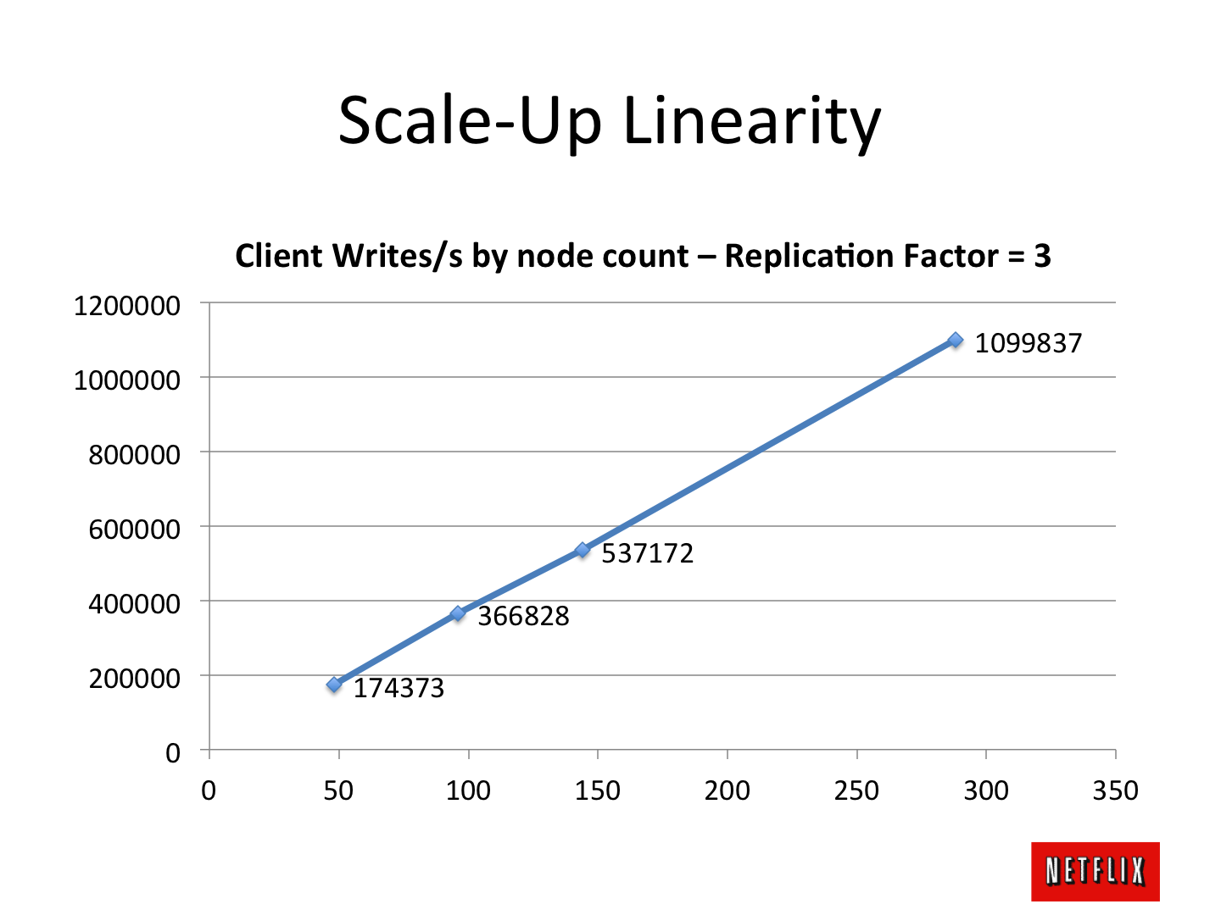
Cassandra at Netflix
http://techblog.netflix.com/2011/11/benchmarking-cassandra-scalability-on.html

Slide 42
Column-based
Name | Producer | Data model | Querying
BigTable | Google | set of couples (key, {value}) | selection (by combination of row, column, and time stamp ranges)
HBase | Apache | groups of columns (a BigTable clone) | JRUBY IRB-based shell (similar to SQL)
Hypertable | Hypertable | like BigTable | HQL (Hypertext Query Language)
CASSANDRA | Apache (originally Facebook) | columns, groups of columns corresponding to a key (supercolumns) | simple selections on key, range queries, column or columns ranges
PNUTS | Yahoo | (hashed or ordered) tables, typed arrays, flexible schema | selection and projection from a single table (retrieve an arbitrary single record by primary key, range queries, complex predicates, ordering, top-k)

Slide 43

Graph-based
Focus on modeling the structure of data (interconnectivity)
Scales to the complexity of data
Inspired by mathematical Graph Theory (G=(E,V))
Data model:
(Property Graph) nodes and edges
Nodes may have properties (including ID)
Edges may have labels or roles
Key-value pairs on both
Interfaces and query languages vary
Single-step vs path expressions vs full recursion
Example:
Neo4j, OrientDB, FlockDB, Pregel, InfoGrid …

Slide 44

Neo4J
Nodes, Relationship.
Traversals.
HTTP/REST.
ACID.
Web Admin.
Not too much support for languages.
Has transactions.

Slide 47
Conclusion
NOSQL database cover only a part of data-intensive cloud applications (mainly Web applications)
Problems with cloud computing:
SaaS (Software as a Service or on-demand software) applications require enterprise-level functionality, including ACID transactions, security, and other features associated with commercial RDBMS technology, i.e. NoSQL should not be the only option in the cloud
Hybrid solutions:
Voldemort with MySQL as one of storage backend
deal with NOSQL data as semi-structured data
→ integrating RDBMS and NoSQL via SQL/XML

Slide 48
Conclusion
next generation of highly scalable and elastic RDBMS: NewSQL databases (from April 2011)
they are designed to scale out horizontally on shared nothing machines,
still provide ACID guarantees,
applications interact with the database primarily using SQL,
the system employs a lock-free concurrency control scheme to avoid user shut down,
the system provides higher performance than available from the traditional systems.
Examples: MySQL Cluster (most mature solution), VoltDB, Clustrix, ScalArc, etc.

Slide 49
SQL Fights Back …

Slide 50

Flying on ACID!

Slide 51
What is NeWSQL??
451 Group’s Definition …
• A DBMS that delivers the scalability and flexibility promised by NoSQL, while retaining the support for SQL queries and/or ACID, or to improve performance for appropriate workloads.
Michael Stonebraker’s Definition …
• SQL as the primary interface.
• ACID support for transactions
• Non-locking concurrency control.
• High per-node performance.
• Parallel, shared-nothing architecture – each node is independent and self-sufficient – do not share memory or storage

Slide 52
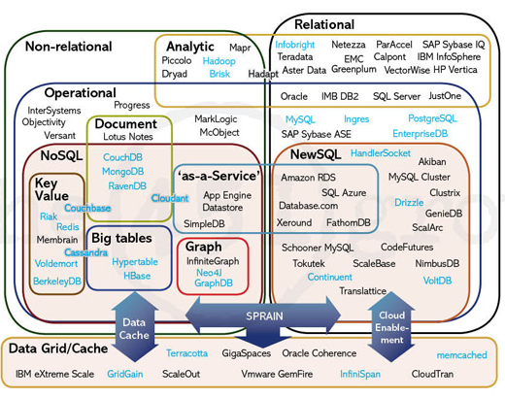
The Big Picture
http://blogs.the451group.com/opensource/2011/04/15/nosql-newsql-and-beyond-the-answer-to-sprained-relational-databases/

Slide 53
NewSQL
NewSQL is a class of database systems that aims to provide the same scalable performance of NoSQL systems while still maintaining the ACID guarantees of a traditional single-node database system.
When should you use NewSQL?
When the application needs to handle very large datasets or a very large number of transactions
When ACID guarantees are required
When the application can significantly benefit from the use of the relational model and SQL
Related Article (Communications of the ACM)
http://cacm.acm.org/blogs/blog-cacm/109710-new-sql-an-alternative-to-nosql-and-old-sql-for-new-oltp-apps/fulltext

Slide 54
NewSQL Database Features
Support the relational data model
Use SQL as the primary mechanism for application interaction
ACID support for transactions
A non-locking concurrency control mechanism so real-time reads will not conflict with writes, and thereby cause them to stall
A scale-out, shared-nothing architecture, capable of running on a large number of nodes without bottlenecking
An architecture providing much higher per-node performance than available from traditional databases
Modified from http://cacm.acm.org/blogs/blog-cacm/109710-new-sql-an-alternative-to-nosql-and-old-sql-for-new-oltp-apps/fulltext

Slide 55
NewSQL Systems
New Architectures
New database platforms designed to operate in a distributed cluster of shared-nothing nodes
Examples: VoltDB, NuoDB, Clustrix, and VMware's SQLFire
MySQL Engines
Highly optimized storage engines for MySQL.
Use the same programming interface as MySQL but scale better
Examples: TokuDB, MemSQL, and Akiban
Transparent Sharding
These systems provide a sharding middleware layer to automatically split databases across multiple nodes
Examples: dbShards, ScaleBase and ScaleDB
Modified from http://en.wikipedia.org/wiki/NewSQL

Slide 56
Technology is still in its infancy – only two years old.
Google’s Spanner is an implementation of NewSQL.
http://static.googleusercontent.com/external_content/untrusted_dlcp/research.google.com/en//archive/spanner-osdi2012.pdf
http://www.clustrix.com/Portals/146389/docs/451-How%20will%20the%20database%20incumbents%20respond%20to%20NoSQL%20and%20NewSQL.pdf
http://cacm.acm.org/blogs/blog-cacm/109710-new-sql-an-alternative-to-nosql-and-old-sql-for-new-oltp-apps/fulltext
http://highscalability.com/blog/2012/9/24/google-spanners-most-surprising-revelation-nosql-is-out-and.html
http://www.linuxforu.com/2012/01/newsql-handle-big-data/

Slide 57
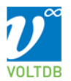
VoltDB
https://voltdb.com

Slide 58
VoltDB
In-memory database
ACID-compliant RDBMS
Uses a shared nothing architecture
Written in Java and C++
Supported operating systems: Linux and Mac OS X
Provides client libraries for Java, C++, C#, PHP, Python and Node.js

Slide 59
ACID in VoltDB
Atomicity
VoltDB defines a transaction as a stored procedure, which either succeeds or rolls back on failure
Consistency
VoltDB enforces schema and datatype constraints in all database queries
Isolation
VoltDB transactions are globally ordered and run to completion on all affected partitions without interleaving
Durability
VoltDB provides replication of partitions, and periodic database snapshots combined with command logging to ensure high availability and database durability
http://voltdb.com/dig-deeper/faq.php

Slide 60
Big Data in the real world

Slide 61
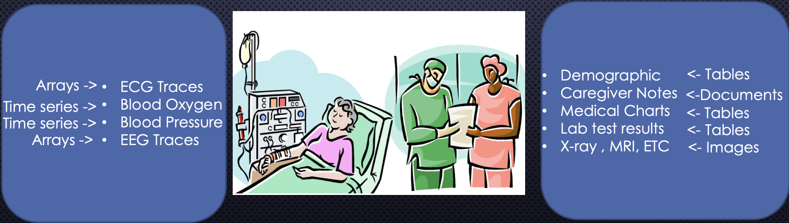

Slide 64
Netflix

Slide 65
Pinterest

Slide 66
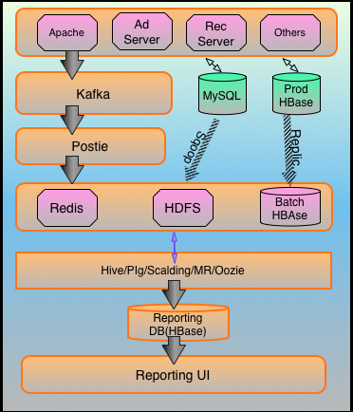
Stumble Upon

Slide 67
https://www.xenonstack.com/blog/big-data-engineering/ingestion-processing-big-data-iot-stream/
Notes:
https://www.xenonstack.com/blog/big-data-engineering/ingestion-processing-big-data-iot-stream/

